Slide 1
Gap Analysis Interactive Map EO 02-2016
This interactive map is intended to illustrate the Washington State Firearm Background Check process. The map is composed of a series of blocks that represent agencies and arrows that represent the transfer of information. The first slide will give you an overview of the background check process for an individual carrying a Concealed Pistol License, but from there the order in which you view the process is at your discretion. Click on the buttons contained in each slide to navigate through the map.
Buttons shaped like this will open documents. When you are done reading them, press either the document or the button to hide it again.
When you see this button in the upper left, you may press it to view a full list of the gaps found during the analysis.
This button will spell out any acronyms contained in the document.
When you are ready, click the green button below to get started.
Doc
!
?
Exit
With CPL

Slide 2
!
List of potential gaps
Background Check Overview: W/CPL
Long guns approved
?
Acronym Finder
NCIC
NICS
Criminal History (III)
Request for firearm purchase or transfer w/CPL
FFL Initiates NICS Check
Firearm given to purchaser
Purchase/ transfer of handgun approved
Local law enforcement notified to conduct check
Mental health check
Misdemeanor warrants
Protection orders, stolen firearms, citizen status, others?
Only handguns receive local background checks.
^ Click again to close
AOC- Administrative Office of the Courts
CPL- Concealed Pistol License
DOL- Department of Licensing
DSHS- Department of Health and Human Services
FFL- Federal Firearms License (Dealer)
Handgun/pistol- Firearm with a barrel less than 16”
III- Interstate Identification Index (Criminal History)
ITPF- Ineligible to Possess a Firearm
JIS- Judicial Information System
Long gun- Larger firearms such as rifles or shotguns
NCIC- National Crime Information Center (Hot File)
NICS- National Instant Criminal Background Check System
PTA- Pistol Transfer Application
WACIC- Washington Crime Information Center (Hot File)
WASIS- Washington State Identification System (Criminal History)
WSP- Washington State Patrol
DOL PTA Form
*Pistols Only
JIS
AOC
WACIC
Local Criminal Records
Local Mental Health
Exit
W/O CPL
DSHS

Slide 3
!
List of potential gaps
Background Check Overview: Without CPL
?
Acronym Finder
NICS (Long guns only)
Long guns approved
Only handguns receive local background checks.
^ Click again to close
AOC- Administrative Office of the Courts
CPL- Concealed Pistol License
DOL- Department of Licensing
DSHS- Department of Health and Human Services
FFL- Federal Firearms License (Dealer)
Handgun/pistol- Firearm with a barrel less than 16”
III- Interstate Identification Index (Criminal History)
ITPF- Ineligible to Possess a Firearm
JIS- Judicial Information System
Long gun- Larger firearms such as rifles or shotguns
NCIC- National Crime Information Center (Hot File)
NICS- National Instant Criminal Background Check System
PTA- Pistol Transfer Application
WACIC- Washington Crime Information Center (Hot File)
WASIS- Washington State Identification System (Criminal History)
WSP- Washington State Patrol
Request for firearm purchase or transfer w/o CPL
FFL Initiates NICS Check
Local law enforcement notified to conduct check
DOL PTA Form
*Pistols Only
NICS
Purchase/ transfer of handgun approved
Protection orders, stolen firearms, citizen status, others?
Misdemeanor warrants
Mental health check
JIS
AOC
Local Criminal Records
Local Mental Health
Exit
With CPL
DSHS

Slide 4
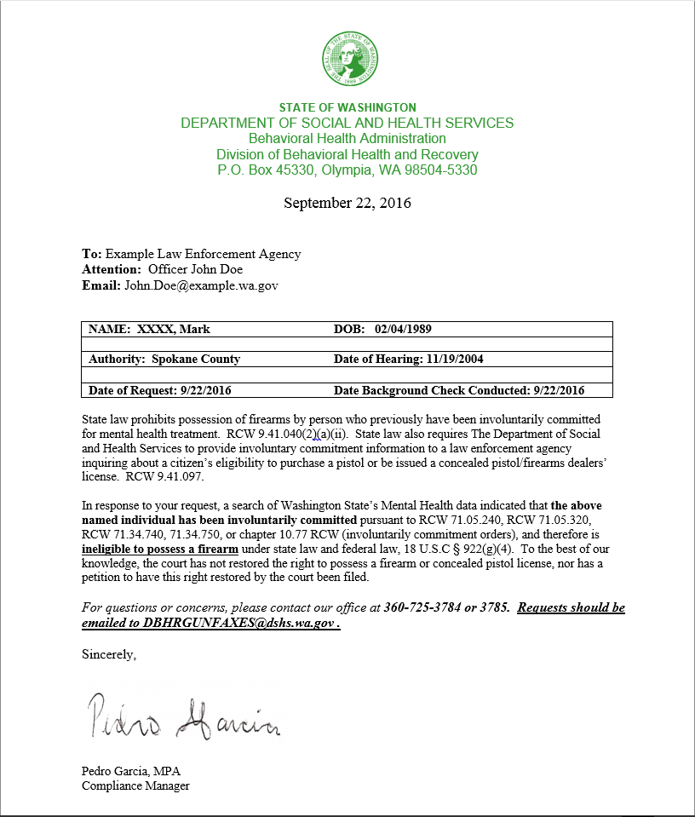
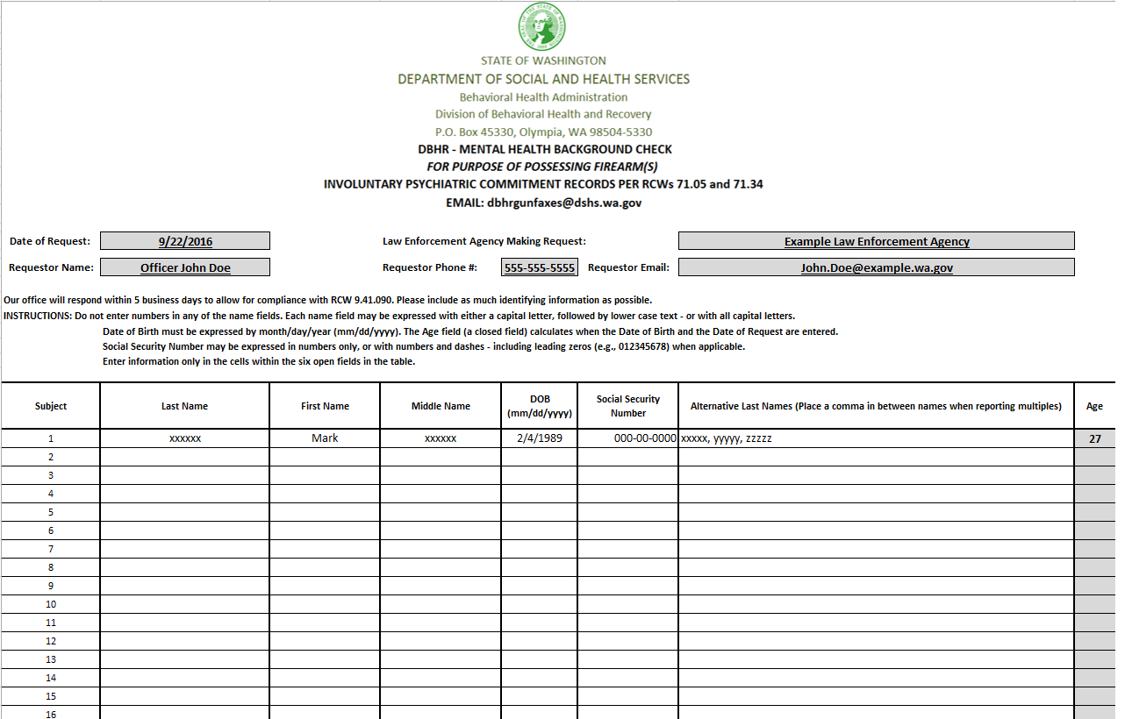
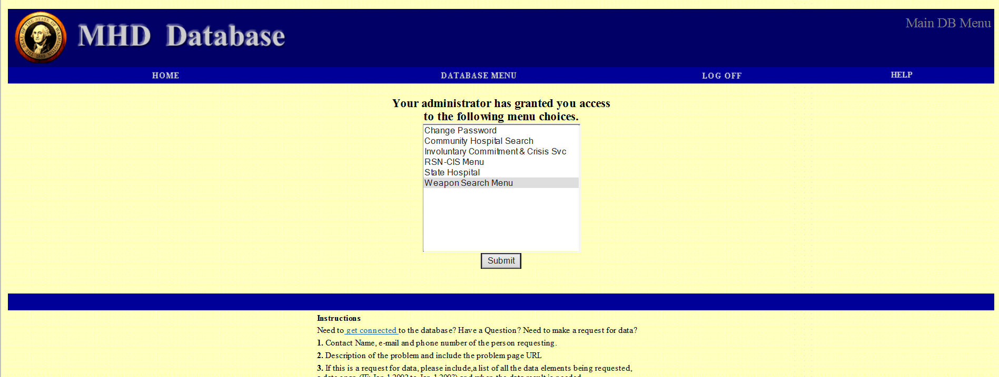
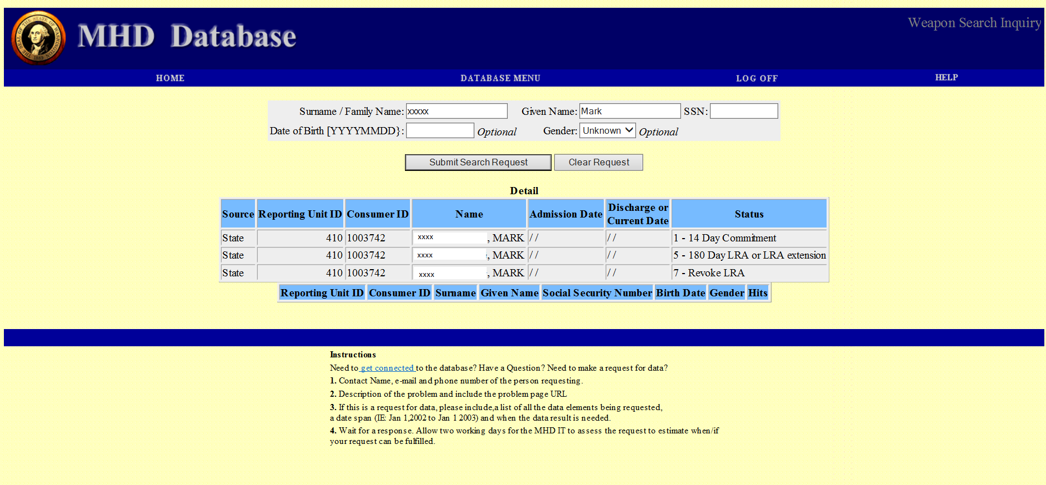
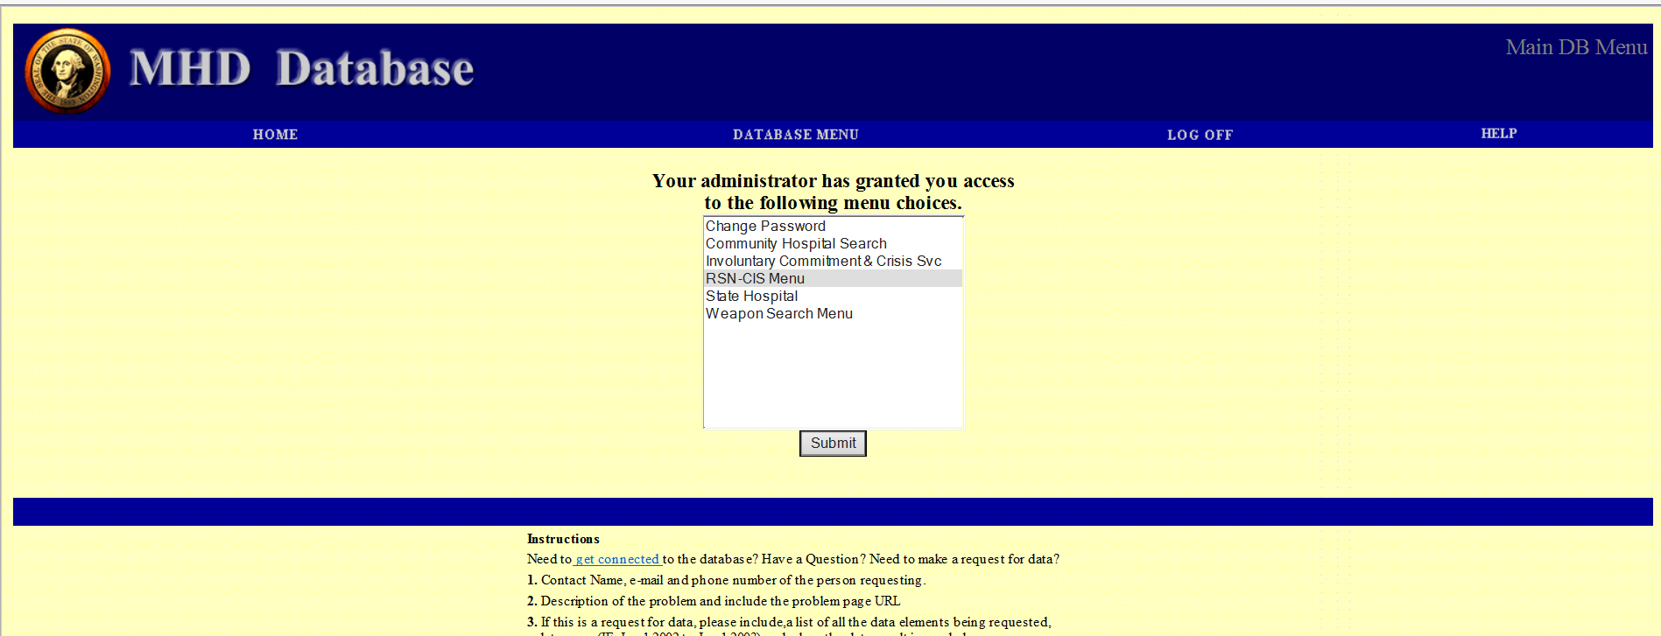
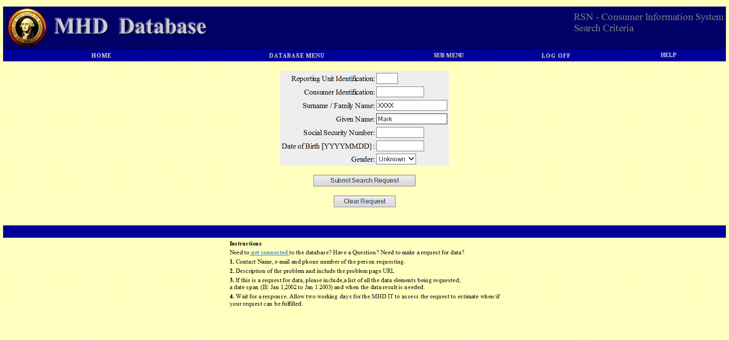
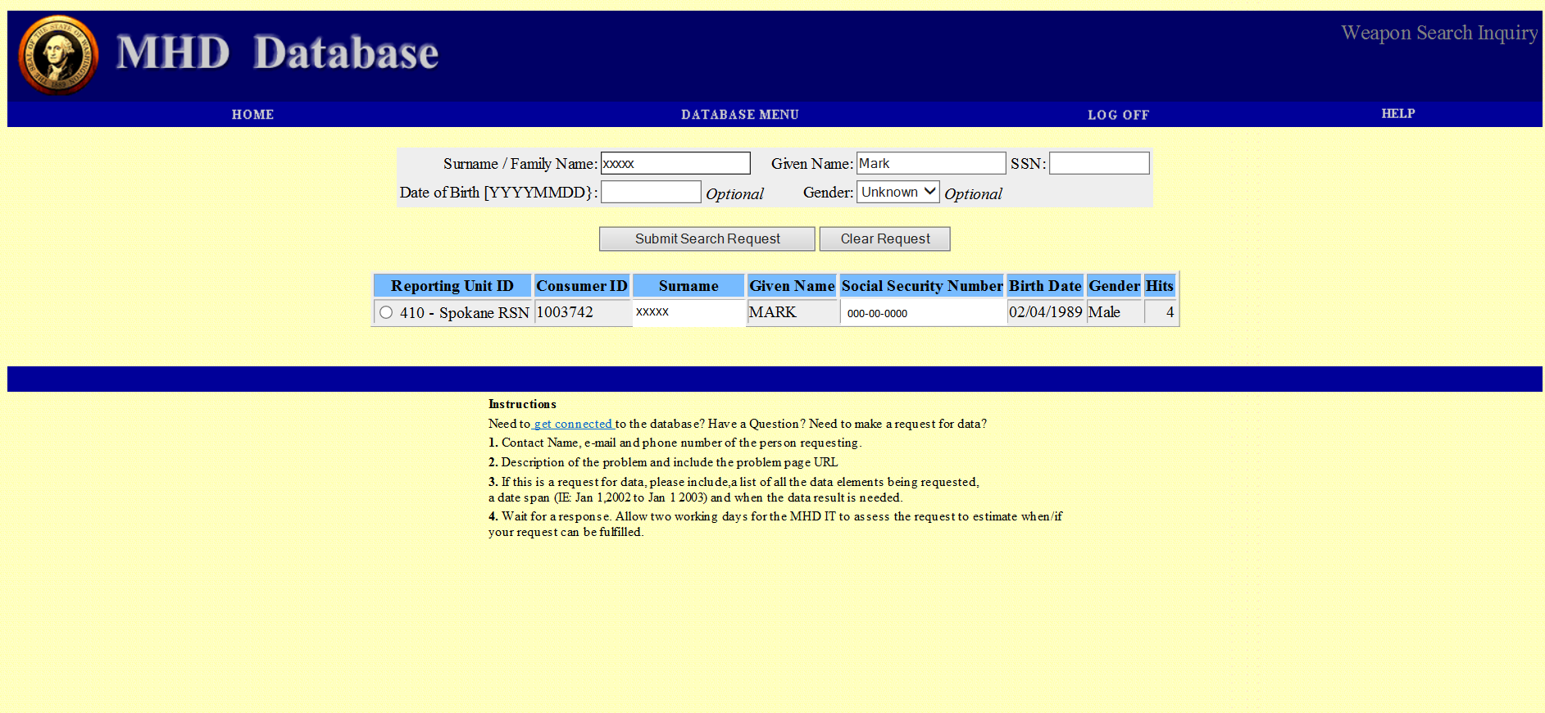
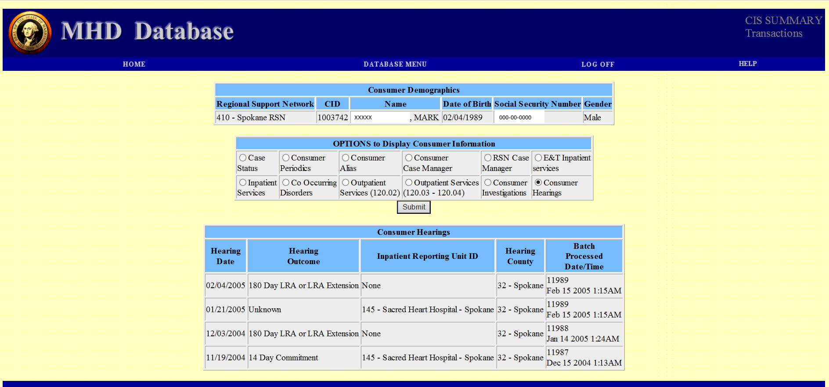
!
List of potential gaps
DSHS Process
?
Acronym Finder
^ Click again to close
AOC- Administrative Office of the Courts
CPL- Concealed Pistol License
DOL- Department of Licensing
DSHS- Department of Health and Human Services
FFL- Federal Firearms License (Dealer)
Handgun/pistol- Firearm with a barrel less than 16”
III- Interstate Identification Index (Criminal History)
ITPF- Ineligible to Possess a Firearm
JIS- Judicial Information System
Long gun- Larger firearms such as rifles or shotguns
NCIC- National Crime Information Center (Hot File)
NICS- National Instant Criminal Background Check System
PTA- Pistol Transfer Application
WACIC- Washington Crime Information Center (Hot File)
WASIS- Washington State Identification System (Criminal History)
WSP- Washington State Patrol
!
Billing Info
Response Letter
Community-Based Providers
Behavioral Health Organizations
DSHS
Law Enforcement Bkgd. Check
Click on MHD pages to look through and close report.
Individual Courts
AOC
Exit
Main

Slide 5
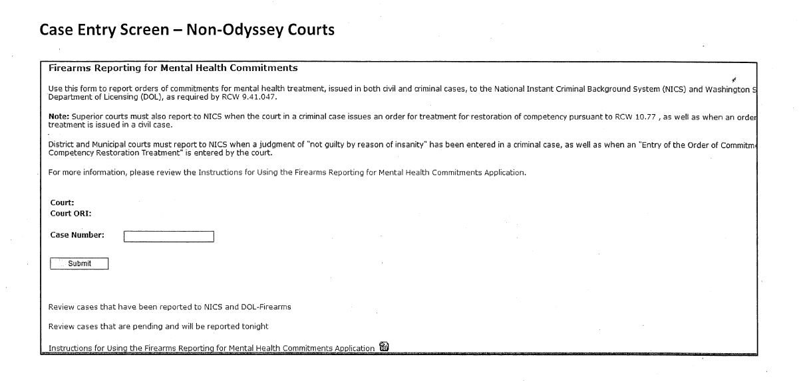
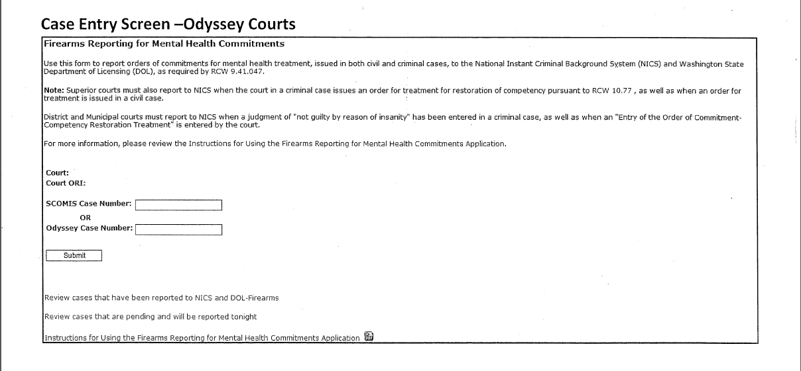
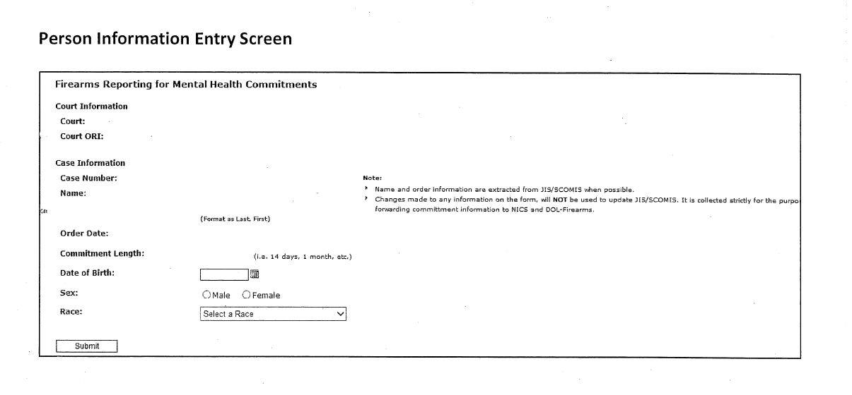
!
List of potential gaps
AOC Process
?
Acronym Finder
WSP
^ Click again to close
AOC- Administrative Office of the Courts
CPL- Concealed Pistol License
DOL- Department of Licensing
DSHS- Department of Health and Human Services
FFL- Federal Firearms License (Dealer)
Handgun/pistol- Firearm with a barrel less than 16”
III- Interstate Identification Index (Criminal History)
ITPF- Ineligible to Possess a Firearm
JIS- Judicial Information System
Long gun- Larger firearms such as rifles or shotguns
NCIC- National Crime Information Center (Hot File)
NICS- National Instant Criminal Background Check System
PTA- Pistol Transfer Application
WACIC- Washington Crime Information Center (Hot File)
WASIS- Washington State Identification System (Criminal History)
WSP- Washington State Patrol
Behavioral Health Organizations
NICS
Individual Courts
Web Transfer App
AOC
Mental Health Prohibitors
!
Washington ID
DOL
Arrests
LEA Check
JIS Database
Click on pages to look through and close documents.
Exit
Main

Slide 6
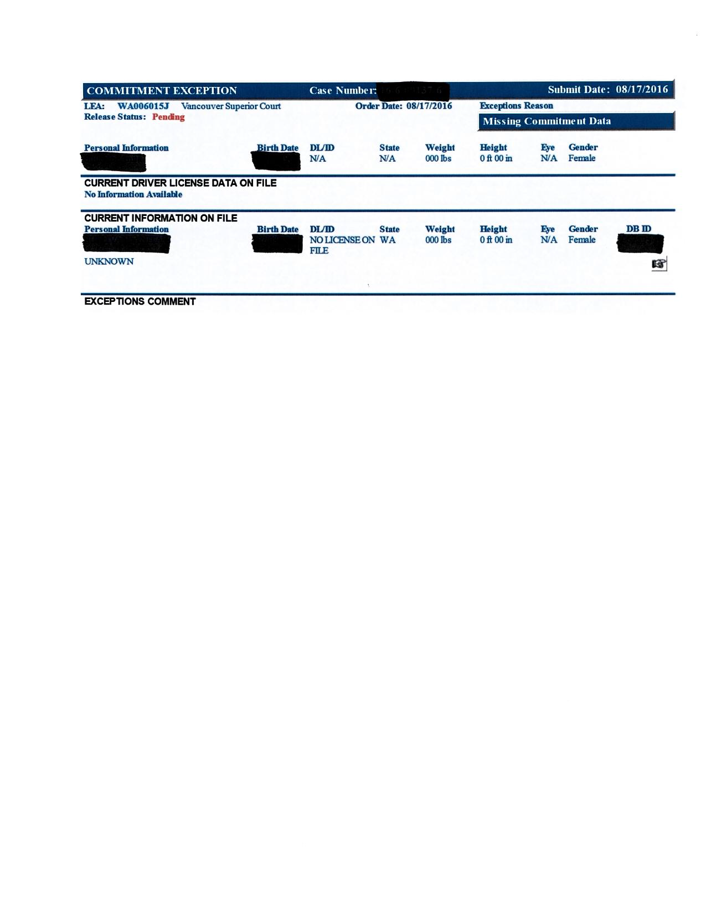
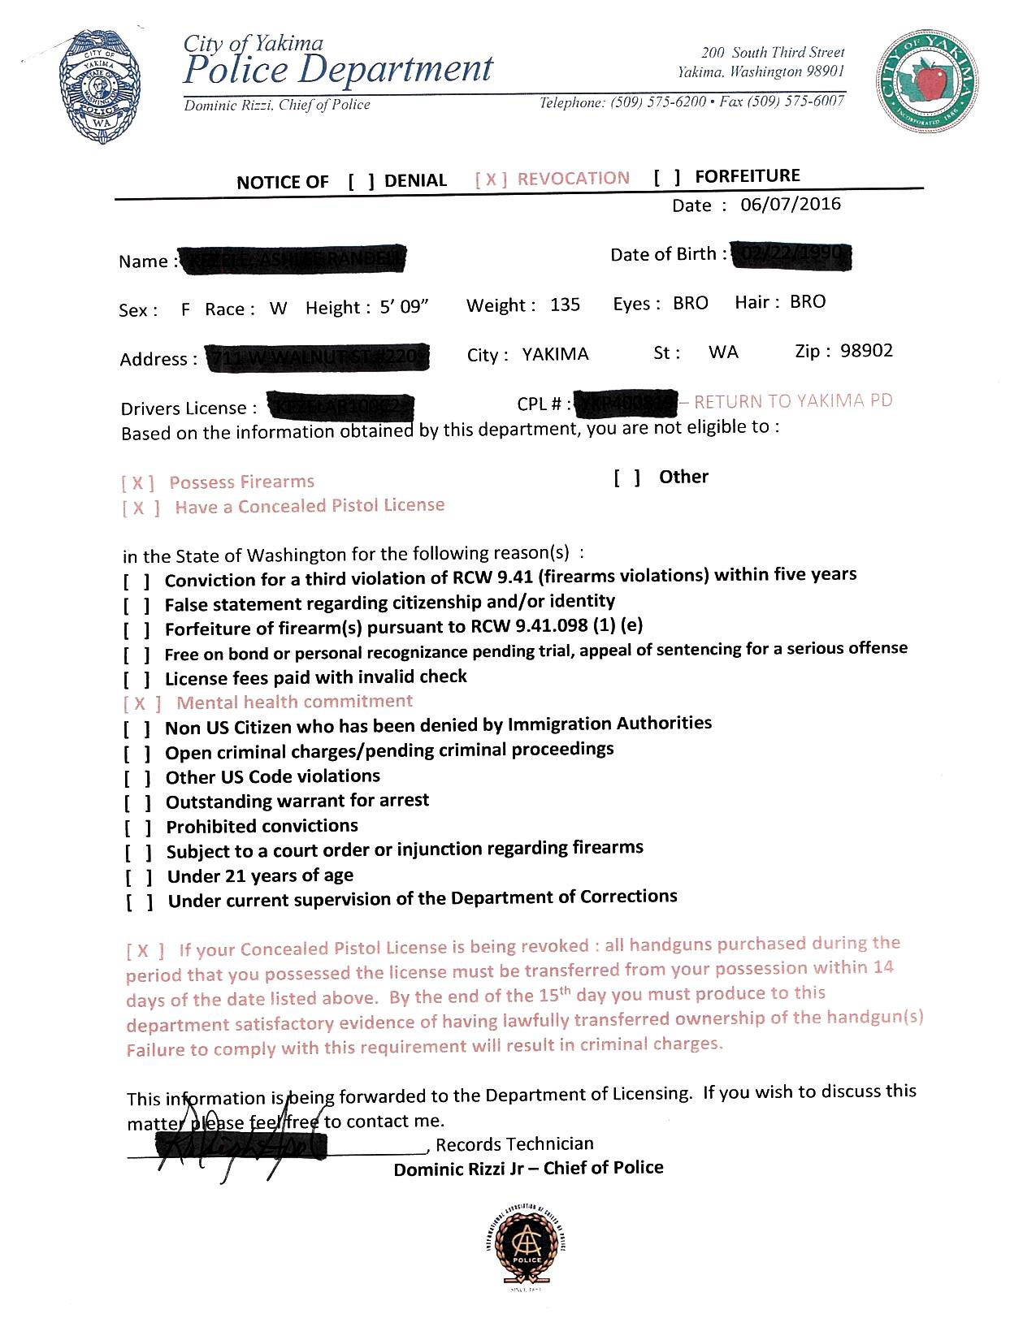
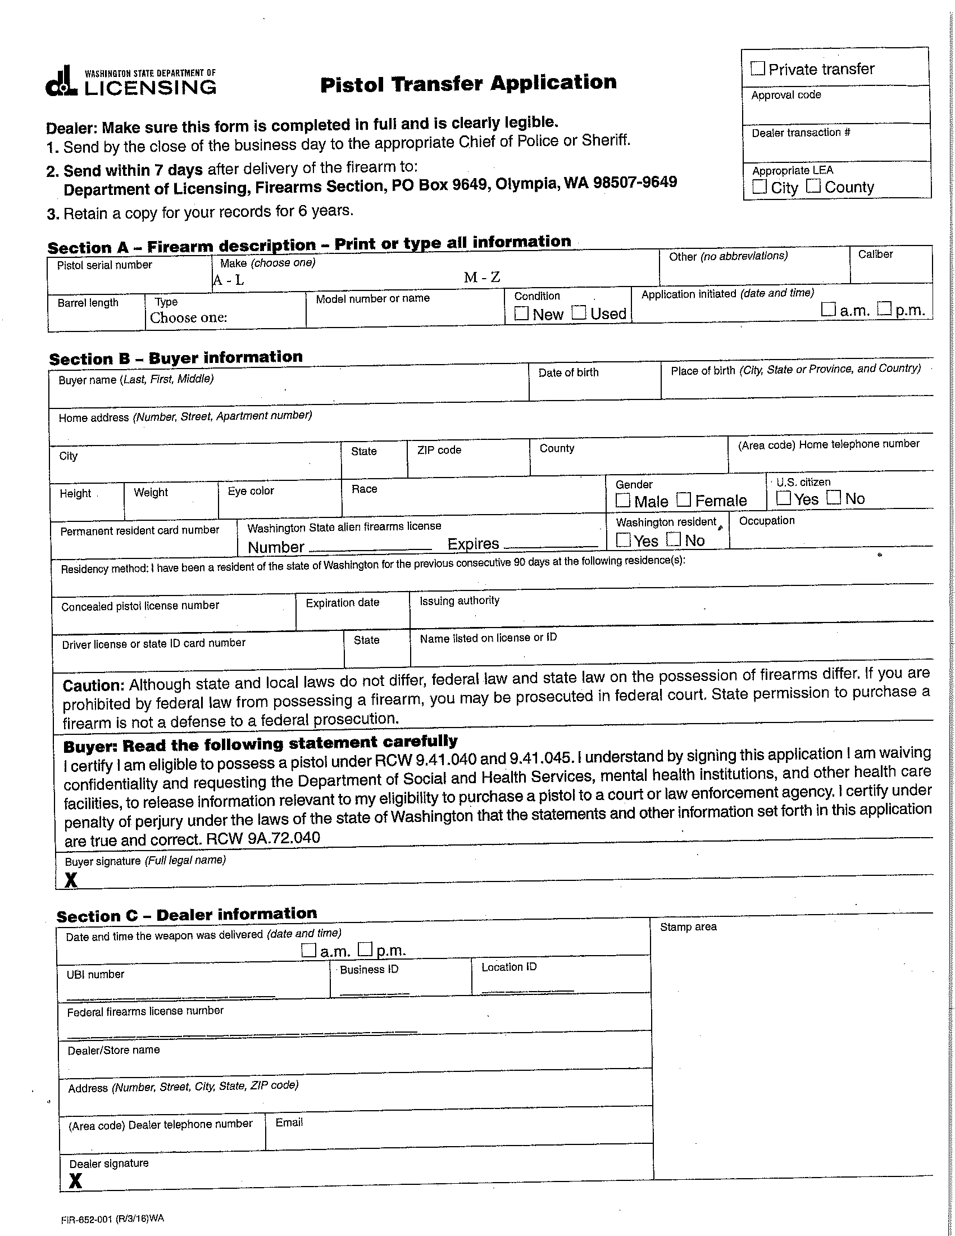
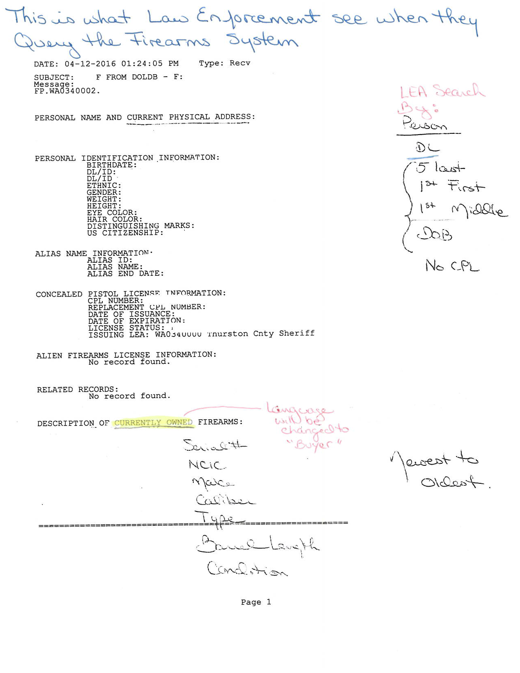
!
List of potential gaps
DOL Process
AOC
?
Acronym Finder
^ Click again to close
AOC- Administrative Office of the Courts
CPL- Concealed Pistol License
DOL- Department of Licensing
DSHS- Department of Health and Human Services
FFL- Federal Firearms License (Dealer)
Handgun/pistol- Firearm with a barrel less than 16”
III- Interstate Identification Index (Criminal History)
ITPF- Ineligible to Possess a Firearm
JIS- Judicial Information System
Long gun- Larger firearms such as rifles or shotguns
NCIC- National Crime Information Center (Hot File)
NICS- National Instant Criminal Background Check System
PTA- Pistol Transfer Application
WACIC- Washington Crime Information Center (Hot File)
WASIS- Washington State Identification System (Criminal History)
WSP- Washington State Patrol
AOC Notice
Revocation/Restoration
ITPF
!
Washington ID
PTA
*Pistols Only
!
FFL Clear NICS Check
DOL
WSP ACCESS
DOL System Info
Revocation/Restoration
LEA Notice
LEA Crime Data
Exit
Main

Slide 7
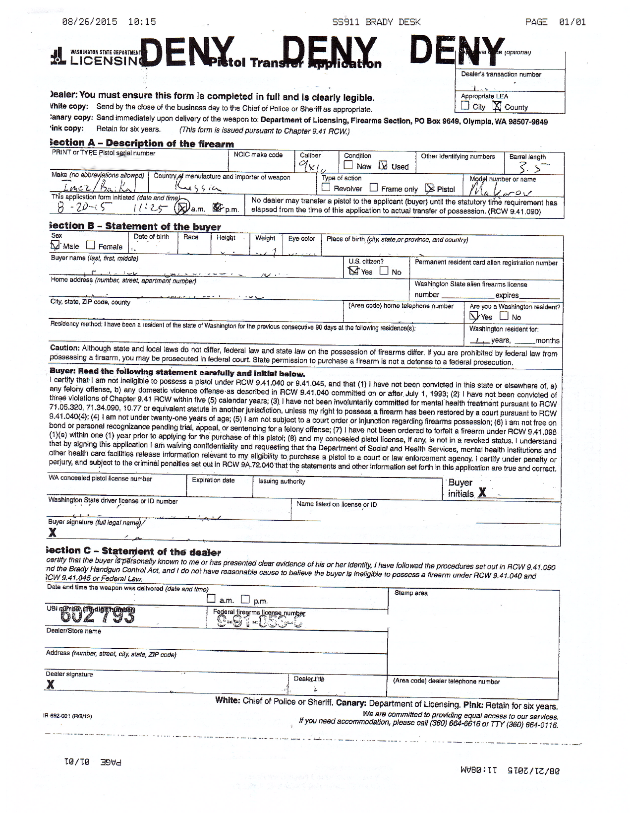
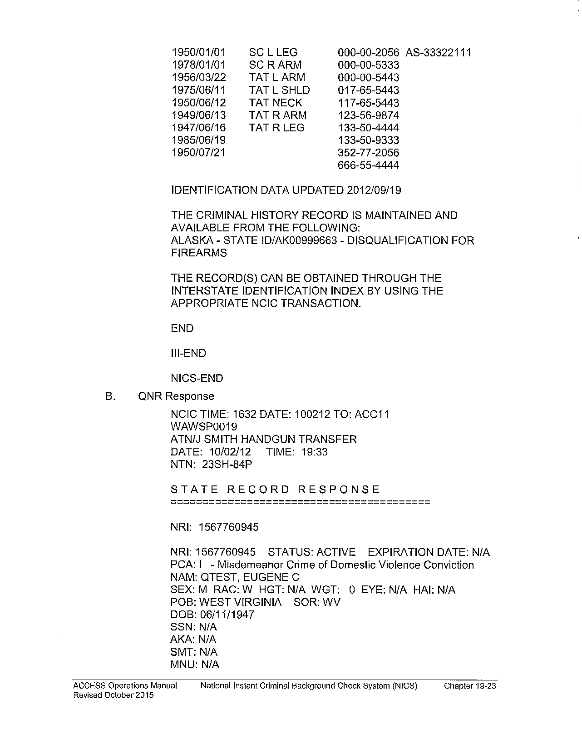
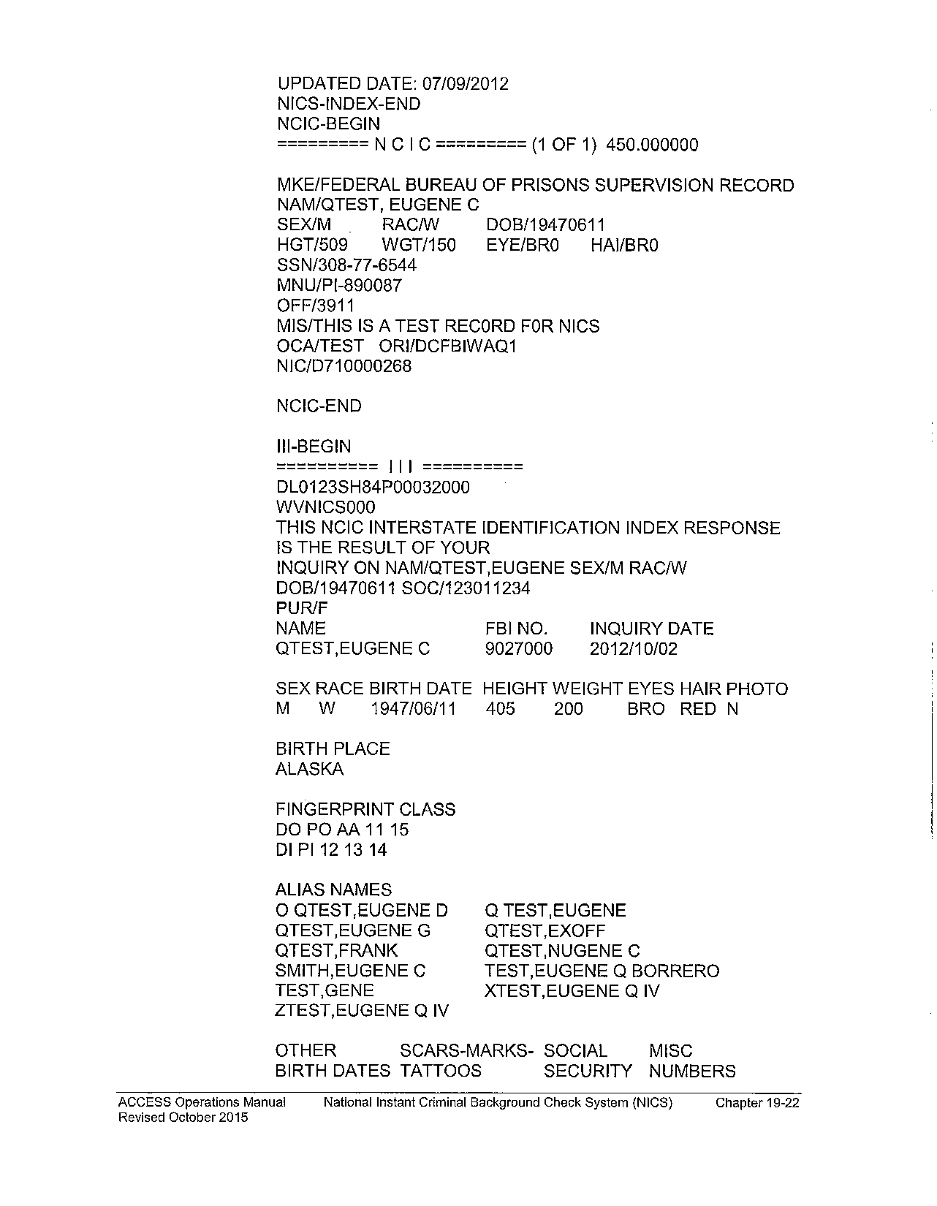
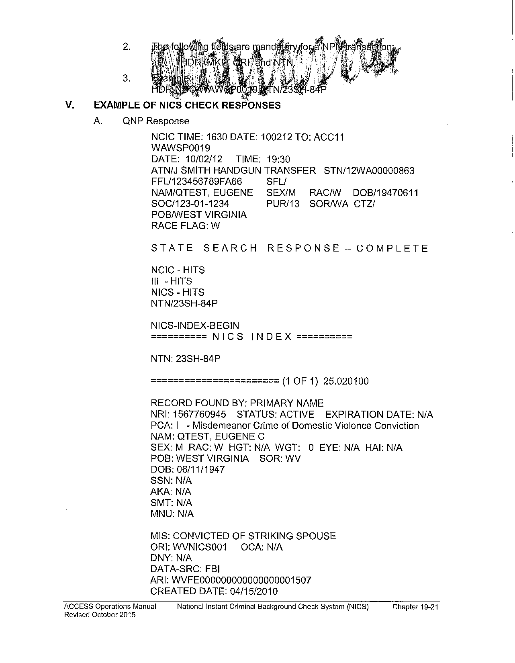
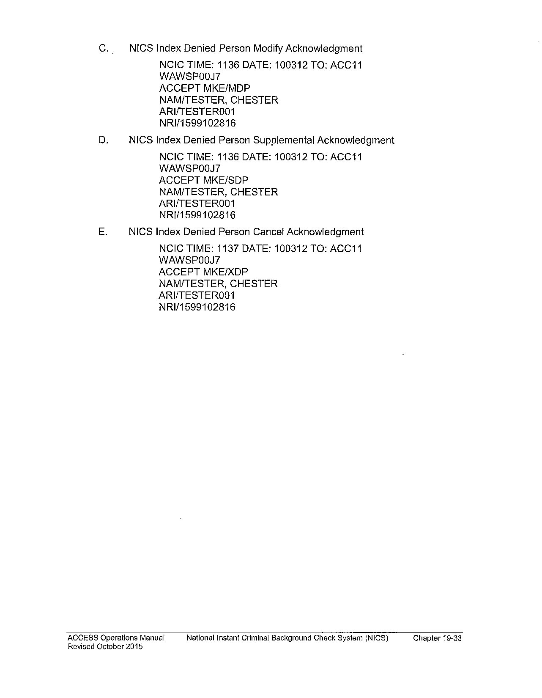
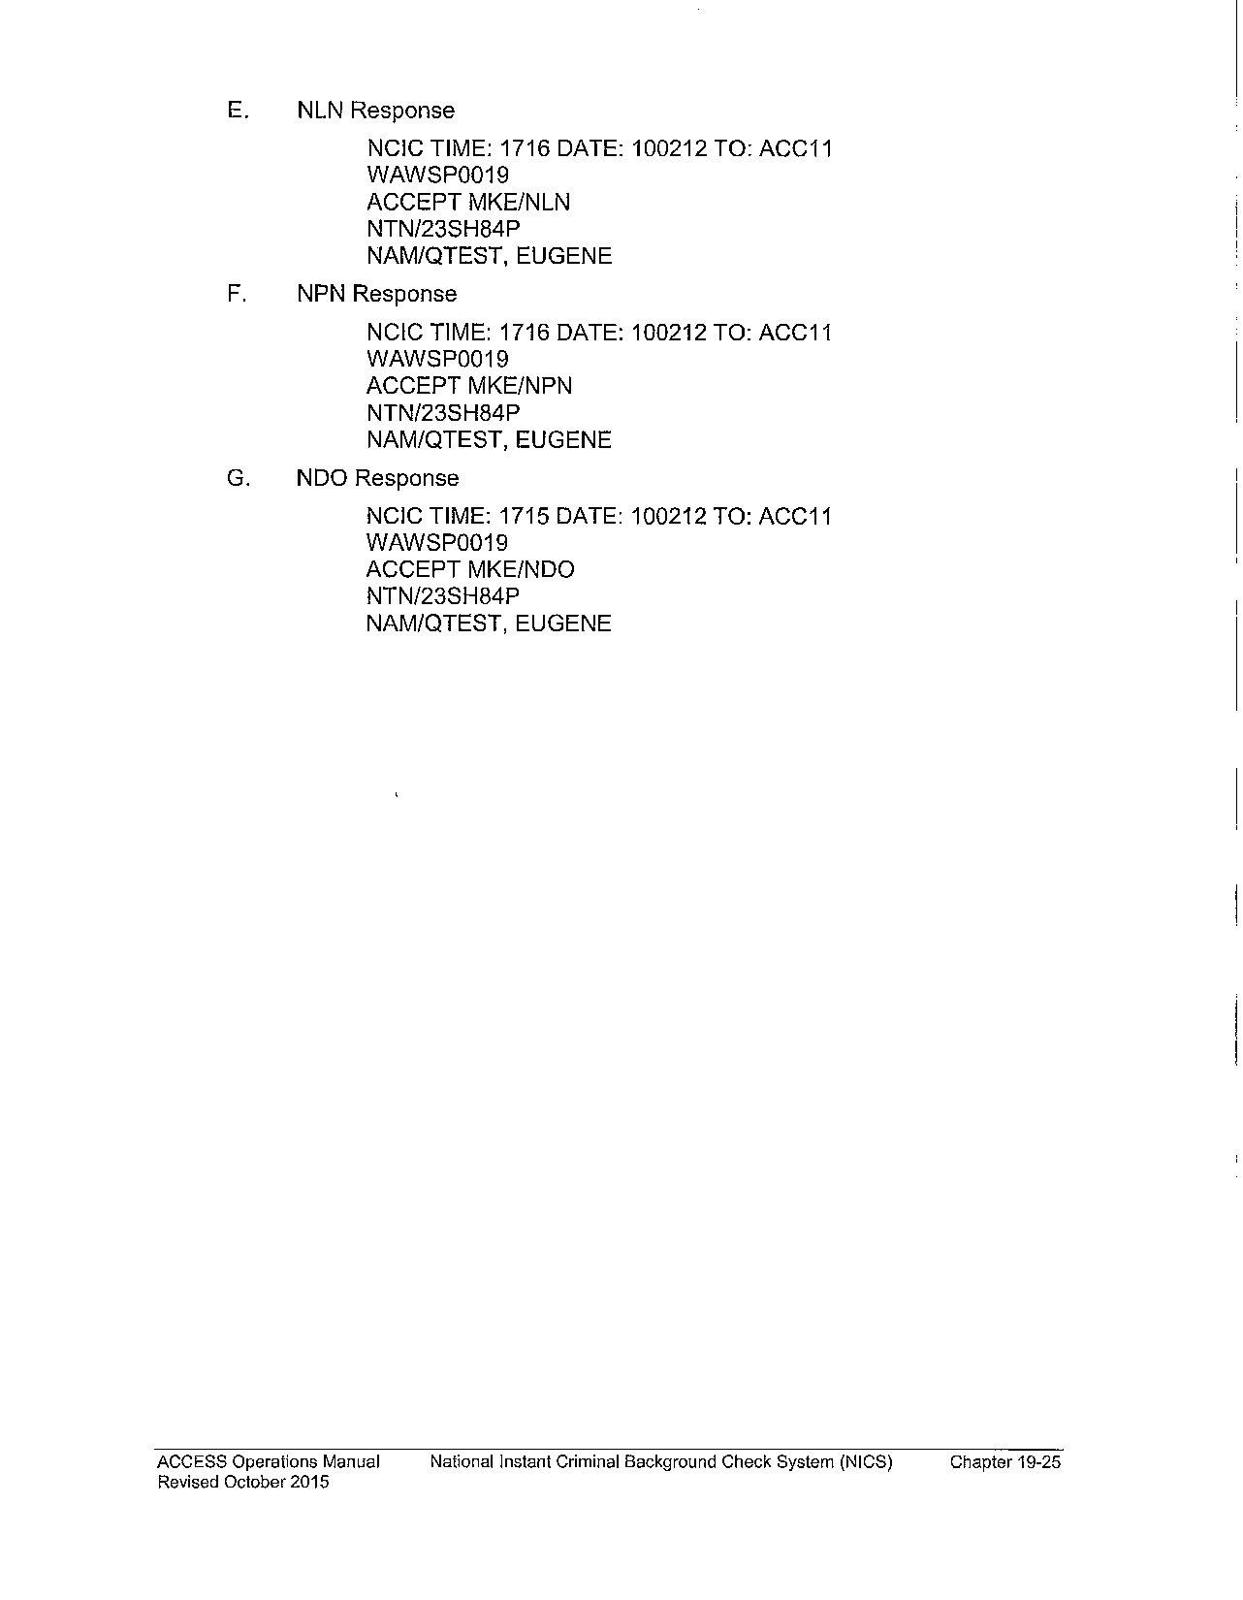
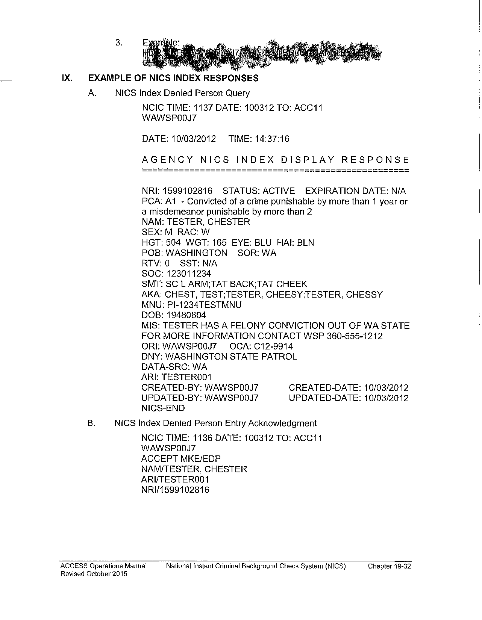
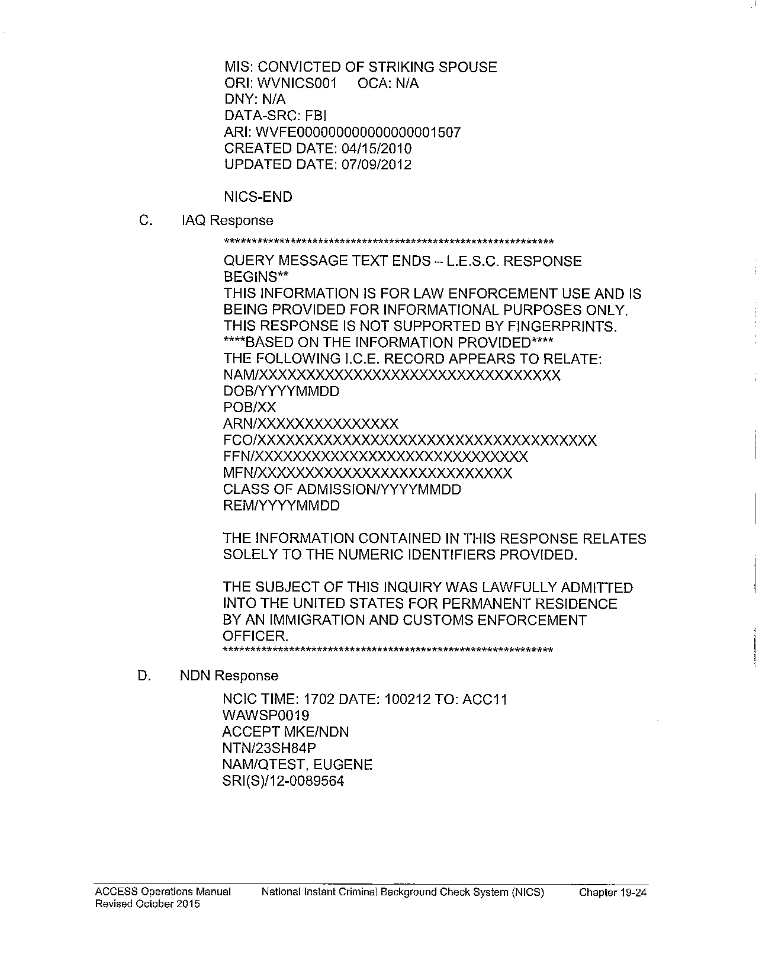
!
List of potential gaps
State Level Bkgd. Check
JIS Database
Local Courts
?
Acronym Finder
!
^ Click again to close
AOC- Administrative Office of the Courts
CPL- Concealed Pistol License
DOL- Department of Licensing
DSHS- Department of Health and Human Services
FFL- Federal Firearms License (Dealer)
Handgun/pistol- Firearm with a barrel less than 16”
III- Interstate Identification Index (Criminal History)
ITPF- Ineligible to Possess a Firearm
JIS- Judicial Information System
Long gun- Larger firearms such as rifles or shotguns
NCIC- National Crime Information Center (Hot File)
NICS- National Instant Criminal Background Check System
PTA- Pistol Transfer Application
WACIC- Washington Crime Information Center (Hot File)
WASIS- Washington State Identification System (Criminal History)
WSP- Washington State Patrol
DSHS
Mental Health Check
Local LEA Database
Additional Warrants and Orders
FFL transfer
!
Local Law Enforcement
LEA Reply to FFL
Pistol Transfer Determination
W/O CPL Only
!
Click on NICS pages to look through and close report.
NICS Return
Additional Prohibitors
NICS
ATF Stolen Gun Serial Numbers
ACCESS Search
WACIC
ICE (Federal Data)
Exit
Main
Immigration

Slide 8
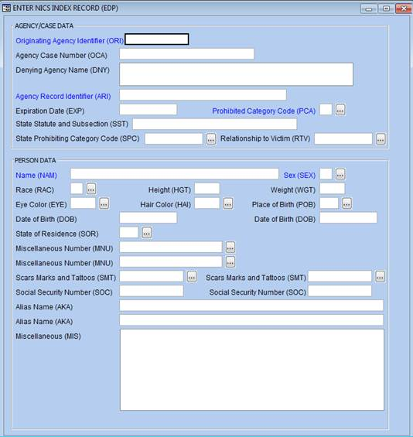
!
List of potential gaps
Law Enforcement Data Process
?
Acronym Finder
DOL
^ Click again to close
AOC- Administrative Office of the Courts
CPL- Concealed Pistol License
DOL- Department of Licensing
DSHS- Department of Health and Human Services
FFL- Federal Firearms License (Dealer)
Handgun/pistol- Firearm with a barrel less than 16”
III- Interstate Identification Index (Criminal History)
ITPF- Ineligible to Possess a Firearm
JIS- Judicial Information System
Long gun- Larger firearms such as rifles or shotguns
NCIC- National Crime Information Center (Hot File)
NICS- National Instant Criminal Background Check System
PTA- Pistol Transfer Application
WACIC- Washington Crime Information Center (Hot File)
WASIS- Washington State Identification System (Criminal History)
WSP- Washington State Patrol
Law Enforcement Bkgd. Check
Revocation/Restoration
Arrests and Warrants
Local LEA Data Entry
!
NICS Index
LEA NICS Index Entry
Arrests
WSP
Individual Courts
Exit
Main

Slide 9
!
List of potential gaps
NICS Data Process
?
Acronym Finder
^ Click again to close
AOC- Administrative Office of the Courts
CPL- Concealed Pistol License
DOL- Department of Licensing
DSHS- Department of Health and Human Services
FFL- Federal Firearms License (Dealer)
Handgun/pistol- Firearm with a barrel less than 16”
III- Interstate Identification Index (Criminal History)
ITPF- Ineligible to Possess a Firearm
JIS- Judicial Information System
Long gun- Larger firearms such as rifles or shotguns
NCIC- National Crime Information Center (Hot File)
NICS- National Instant Criminal Background Check System
PTA- Pistol Transfer Application
WACIC- Washington Crime Information Center (Hot File)
WASIS- Washington State Identification System (Criminal History)
WSP- Washington State Patrol
WACIC
NCIC
FFL Check
WASIS
III
With CPL
NICS
!
LEA Crime Data
NICS Index
W/O CPL
LEA Check
AOC
Exit
Main

Slide 10
!
List of potential gaps
Criminal History Data Process
?
Acronym Finder
^ Click again to close
AOC- Administrative Office of the Courts
CPL- Concealed Pistol License
DOL- Department of Licensing
DSHS- Department of Health and Human Services
FFL- Federal Firearms License (Dealer)
Handgun/pistol- Firearm with a barrel less than 16”
III- Interstate Identification Index (Criminal History)
ITPF- Ineligible to Possess a Firearm
JIS- Judicial Information System
Long gun- Larger firearms such as rifles or shotguns
NCIC- National Crime Information Center (Hot File)
NICS- National Instant Criminal Background Check System
PTA- Pistol Transfer Application
WACIC- Washington Crime Information Center (Hot File)
WASIS- Washington State Identification System (Criminal History)
WSP- Washington State Patrol
WSP
!
WASIS
III
NICS
Federal and Other States
Exit
Main

Slide 11
!
List of potential gaps
Criminal “Hot File” Data Process
?
Acronym Finder
LEA Check
^ Click again to close
AOC- Administrative Office of the Courts
CPL- Concealed Pistol License
DOL- Department of Licensing
DSHS- Department of Health and Human Services
FFL- Federal Firearms License (Dealer)
Handgun/pistol- Firearm with a barrel less than 16”
III- Interstate Identification Index (Criminal History)
ITPF- Ineligible to Possess a Firearm
JIS- Judicial Information System
Long gun- Larger firearms such as rifles or shotguns
NCIC- National Crime Information Center (Hot File)
NICS- National Instant Criminal Background Check System
PTA- Pistol Transfer Application
WACIC- Washington Crime Information Center (Hot File)
WASIS- Washington State Identification System (Criminal History)
WSP- Washington State Patrol
WSP
WACIC
NCIC
NICS
Federal and Other States
Exit
Main

Slide 12
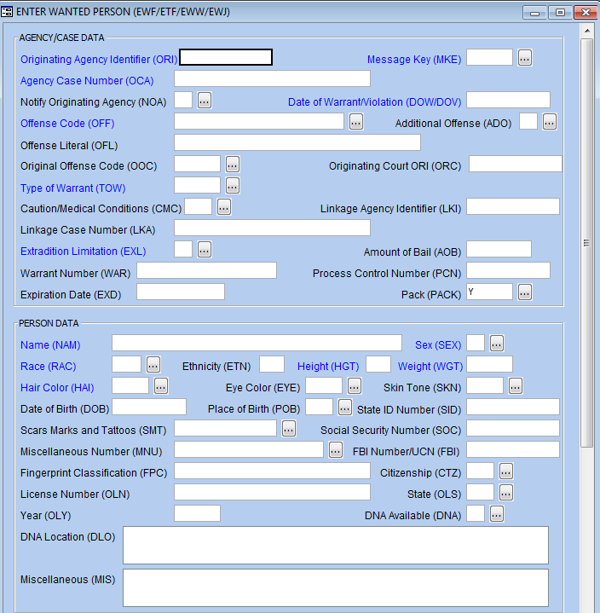
!
List of potential gaps
WSP Process
?
Acronym Finder
^ Click again to close
AOC- Administrative Office of the Courts
CPL- Concealed Pistol License
DOL- Department of Licensing
DSHS- Department of Health and Human Services
FFL- Federal Firearms License (Dealer)
Handgun/pistol- Firearm with a barrel less than 16”
III- Interstate Identification Index (Criminal History)
ITPF- Ineligible to Possess a Firearm
JIS- Judicial Information System
Long gun- Larger firearms such as rifles or shotguns
NCIC- National Crime Information Center (Hot File)
NICS- National Instant Criminal Background Check System
PTA- Pistol Transfer Application
WACIC- Washington Crime Information Center (Hot File)
WASIS- Washington State Identification System (Criminal History)
WSP- Washington State Patrol
AOC
WASIS
WSP
LEA Crime Data
WACIC
LEA Warrant Entry
Exit
Main

Slide 13
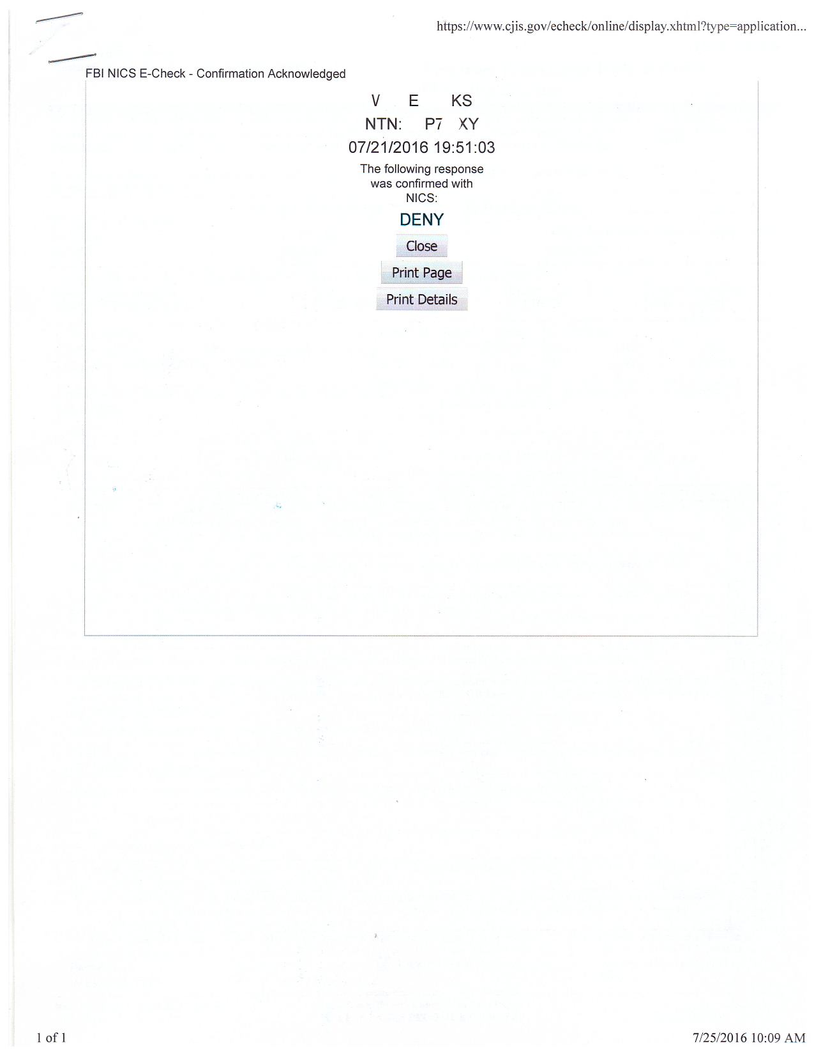
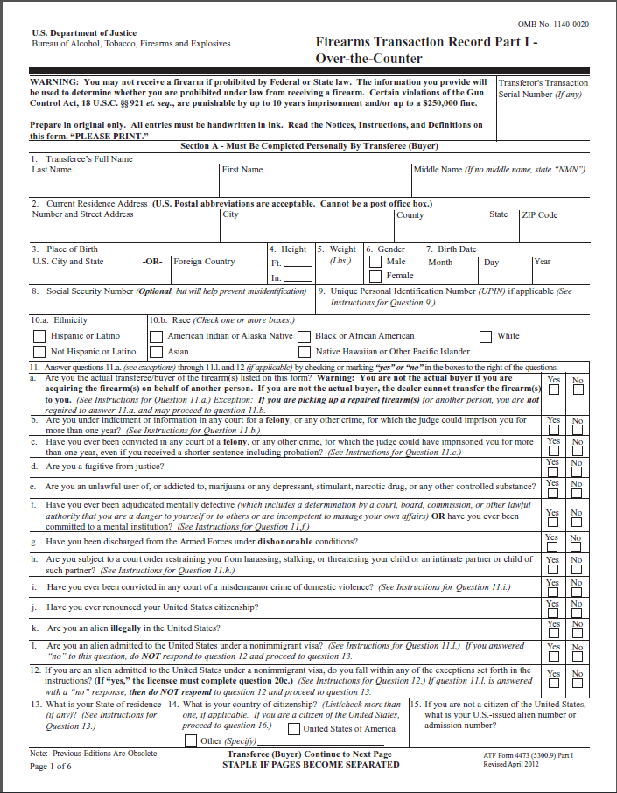
!
List of potential gaps
FFL Process
?
Acronym Finder
^ Click again to close
AOC- Administrative Office of the Courts
CPL- Concealed Pistol License
DOL- Department of Licensing
DSHS- Department of Health and Human Services
FFL- Federal Firearms License (Dealer)
Handgun/pistol- Firearm with a barrel less than 16”
III- Interstate Identification Index (Criminal History)
ITPF- Ineligible to Possess a Firearm
JIS- Judicial Information System
Long gun- Larger firearms such as rifles or shotguns
NCIC- National Crime Information Center (Hot File)
NICS- National Instant Criminal Background Check System
PTA- Pistol Transfer Application
WACIC- Washington Crime Information Center (Hot File)
WASIS- Washington State Identification System (Criminal History)
WSP- Washington State Patrol
NICS
NICS Result
Long Guns or W/ CPL Only
DOL
!
Customer Initiates Purchase
Form 4473 Screening
FFL in-store check
Pistols/Handguns Only
Form 4473
Page 1
LEA Check
!
Long gun determination, Pistols given to CPL Carriers
!
!
Exit
Main
After approval or 10 business days, pistol transfer allowed

Slide 14
Law enforcement may not check with DSHS
!
List of potential gaps
?
Acronym Finder
^ Click again to close
AOC- Administrative Office of the Courts
CPL- Concealed Pistol License
DOL- Department of Licensing
DSHS- Department of Health and Human Services
FFL- Federal Firearms License (Dealer)
Handgun/pistol- Firearm with a barrel less than 16”
III- Interstate Identification Index (Criminal History)
ITPF- Ineligible to Possess a Firearm
JIS- Judicial Information System
Long gun- Larger firearms such as rifles or shotguns
NCIC- National Crime Information Center (Hot File)
NICS- National Instant Criminal Background Check System
PTA- Pistol Transfer Application
WACIC- Washington Crime Information Center (Hot File)
WASIS- Washington State Identification System (Criminal History)
WSP- Washington State Patrol
Law enforcement used to check with local behavioral health organizations (BHOs) for up-to date local data on mental health and involuntary commitment.
Since 2014 this information has been submitted to DSHS in real time negating the need to check with BHOs.
Law enforcement agencies that only check with BHOs may miss involuntary commitments from other parts of the state that will be in the DSHS system.
Exit
Main
Back

Slide 15
Potential time delay for mental health data
!
List of potential gaps
?
Acronym Finder
^ Click again to close
AOC- Administrative Office of the Courts
CPL- Concealed Pistol License
DOL- Department of Licensing
DSHS- Department of Health and Human Services
FFL- Federal Firearms License (Dealer)
Handgun/pistol- Firearm with a barrel less than 16”
III- Interstate Identification Index (Criminal History)
ITPF- Ineligible to Possess a Firearm
JIS- Judicial Information System
Long gun- Larger firearms such as rifles or shotguns
NCIC- National Crime Information Center (Hot File)
NICS- National Instant Criminal Background Check System
PTA- Pistol Transfer Application
WACIC- Washington Crime Information Center (Hot File)
WASIS- Washington State Identification System (Criminal History)
WSP- Washington State Patrol
Civil mental health cases use non-well identified persons, and require manual entry of records prior to submission to NICS.
RCW 9.41.047 allows for 3 days to complete the form that sends information on these cases to DOL and NICS.
In cases that take the full 3 days to enter NICS, involuntarily committed people that purchase firearms directly following their commitment may not be flagged in the system at the time of the NICS check.
Exit
Main
Back

Slide 16
No retention of mental health data by DOL
!
List of potential gaps
?
Acronym Finder
^ Click again to close
AOC- Administrative Office of the Courts
CPL- Concealed Pistol License
DOL- Department of Licensing
DSHS- Department of Health and Human Services
FFL- Federal Firearms License (Dealer)
Handgun/pistol- Firearm with a barrel less than 16”
III- Interstate Identification Index (Criminal History)
ITPF- Ineligible to Possess a Firearm
JIS- Judicial Information System
Long gun- Larger firearms such as rifles or shotguns
NCIC- National Crime Information Center (Hot File)
NICS- National Instant Criminal Background Check System
PTA- Pistol Transfer Application
WACIC- Washington Crime Information Center (Hot File)
WASIS- Washington State Identification System (Criminal History)
WSP- Washington State Patrol
AOC sends DOL information on those adjudicated ineligible to possess a firearm (not guilty by reason of insanity, court ordered treatment).
DOL checks this information against the database but does NOT store records as RCW 9.41.047(2) only gives authority to run checks.
This means that a person deemed ineligible could enter the system at a later date and would not be flagged in any way; court notification of DOL only works on current CPL holders, not future owners.
Exit
Main
Back

Slide 17
PTAs do not contain prior buyer names
!
List of potential gaps
?
Acronym Finder
^ Click again to close
AOC- Administrative Office of the Courts
CPL- Concealed Pistol License
DOL- Department of Licensing
DSHS- Department of Health and Human Services
FFL- Federal Firearms License (Dealer)
Handgun/pistol- Firearm with a barrel less than 16”
III- Interstate Identification Index (Criminal History)
ITPF- Ineligible to Possess a Firearm
JIS- Judicial Information System
Long gun- Larger firearms such as rifles or shotguns
NCIC- National Crime Information Center (Hot File)
NICS- National Instant Criminal Background Check System
PTA- Pistol Transfer Application
WACIC- Washington Crime Information Center (Hot File)
WASIS- Washington State Identification System (Criminal History)
WSP- Washington State Patrol
Current PTA forms do not include fields requesting for any alternate names the purchaser may have gone by in the past.
AKAs most commonly will detect changes in last names due to marriage, but may also aid in cases of name changes or nicknames.
Because law enforcement and dealers use these names to run checks, not having AKAs provided on the form can cause slowdowns or in some cases return false negatives during checks.
Exit
Main
Back

Slide 18
No follow-up for failed Form 4473 or NICS check
!
List of potential gaps
?
Acronym Finder
^ Click again to close
AOC- Administrative Office of the Courts
CPL- Concealed Pistol License
DOL- Department of Licensing
DSHS- Department of Health and Human Services
FFL- Federal Firearms License (Dealer)
Handgun/pistol- Firearm with a barrel less than 16”
III- Interstate Identification Index (Criminal History)
ITPF- Ineligible to Possess a Firearm
JIS- Judicial Information System
Long gun- Larger firearms such as rifles or shotguns
NCIC- National Crime Information Center (Hot File)
NICS- National Instant Criminal Background Check System
PTA- Pistol Transfer Application
WACIC- Washington Crime Information Center (Hot File)
WASIS- Washington State Identification System (Criminal History)
WSP- Washington State Patrol
Dealers have customers interested in transfers or purchases fill out form 4473 and submit to a background check.
If a customer fails a check, no information is provided to the dealer as to why this is, and the customer is free to leave.
Failed checks are kept by the business, and are not uploaded to any centralized database.
Because Form 4473 is entirely self-declared, a prohibited individual may have another chance at passing the form, or at obtaining a firearm through any other means.
Exit
Main
Back

Slide 19
Long guns receive a reduced check
!
List of potential gaps
?
Acronym Finder
^ Click again to close
AOC- Administrative Office of the Courts
CPL- Concealed Pistol License
DOL- Department of Licensing
DSHS- Department of Health and Human Services
FFL- Federal Firearms License (Dealer)
Handgun/pistol- Firearm with a barrel less than 16”
III- Interstate Identification Index (Criminal History)
ITPF- Ineligible to Possess a Firearm
JIS- Judicial Information System
Long gun- Larger firearms such as rifles or shotguns
NCIC- National Crime Information Center (Hot File)
NICS- National Instant Criminal Background Check System
PTA- Pistol Transfer Application
WACIC- Washington Crime Information Center (Hot File)
WASIS- Washington State Identification System (Criminal History)
WSP- Washington State Patrol
By law, long guns such as rifles and shotguns are not required to undergo any additional background check by law enforcement before a transfer.
Retaining a CPL does not alter the check received during long gun purchases in any way.
Due to the gaps in some information being entered into NICS and the additional investigative power of law enforcement, long guns receive a less complete check than pistols yet have no fewer prohibitors.
Exit
Main
Back

Slide 20
Dealers cannot verify CPL on site
!
List of potential gaps
?
Acronym Finder
^ Click again to close
AOC- Administrative Office of the Courts
CPL- Concealed Pistol License
DOL- Department of Licensing
DSHS- Department of Health and Human Services
FFL- Federal Firearms License (Dealer)
Handgun/pistol- Firearm with a barrel less than 16”
III- Interstate Identification Index (Criminal History)
ITPF- Ineligible to Possess a Firearm
JIS- Judicial Information System
Long gun- Larger firearms such as rifles or shotguns
NCIC- National Crime Information Center (Hot File)
NICS- National Instant Criminal Background Check System
PTA- Pistol Transfer Application
WACIC- Washington Crime Information Center (Hot File)
WASIS- Washington State Identification System (Criminal History)
WSP- Washington State Patrol
When participating in a handgun transaction, dealers have the option to transfer possession following a federal background check if the recipient presents a valid CPL.
Unlike law enforcement, dealers have no immediate way to verify the authenticity of a CPL, and the current license format does not include a picture of the holder.
Dealers may be at risk to unknowingly transfer a handgun to an individual with an invalid CPL, which would only be detected by law enforcement after the fact.
Exit
Main
Back

Slide 21
Lack of clarity in firearm surrender process
!
List of potential gaps
?
Acronym Finder
^ Click again to close
AOC- Administrative Office of the Courts
CPL- Concealed Pistol License
DOL- Department of Licensing
DSHS- Department of Health and Human Services
FFL- Federal Firearms License (Dealer)
Handgun/pistol- Firearm with a barrel less than 16”
III- Interstate Identification Index (Criminal History)
ITPF- Ineligible to Possess a Firearm
JIS- Judicial Information System
Long gun- Larger firearms such as rifles or shotguns
NCIC- National Crime Information Center (Hot File)
NICS- National Instant Criminal Background Check System
PTA- Pistol Transfer Application
WACIC- Washington Crime Information Center (Hot File)
WASIS- Washington State Identification System (Criminal History)
WSP- Washington State Patrol
In cases with CPL carriers or in some cases when the law enforcement background check exceeds 10 days (9.41.094) with a non-CPL carrier, FFLs will transfer the firearm prior to receiving the results of the check (9.41.090).
In the event that the check turns up a prohibitor and the transfer is denied, there is no clear process for retrieving the firearm.
While these cases may be reduced by speeding up the check process, this will be a persistent issue with CPL carriers and will allow some individuals who have failed checks to retain firearms.
Exit
Main
Back

Slide 22
Unknown dispositions delay checks
!
List of potential gaps
?
Acronym Finder
^ Click again to close
AOC- Administrative Office of the Courts
CPL- Concealed Pistol License
DOL- Department of Licensing
DSHS- Department of Health and Human Services
FFL- Federal Firearms License (Dealer)
Handgun/pistol- Firearm with a barrel less than 16”
III- Interstate Identification Index (Criminal History)
ITPF- Ineligible to Possess a Firearm
JIS- Judicial Information System
Long gun- Larger firearms such as rifles or shotguns
NCIC- National Crime Information Center (Hot File)
NICS- National Instant Criminal Background Check System
PTA- Pistol Transfer Application
WACIC- Washington Crime Information Center (Hot File)
WASIS- Washington State Identification System (Criminal History)
WSP- Washington State Patrol
When law enforcement wishes to check for incomplete dispositions or other missing information regarding a criminal offense, they must contact the arresting agency and often the associated court
Many courts charge fees, and some take multiple weeks to reply. In some cases, these courts are out of state.
Delays caused by checking incomplete records, especially during high volume periods, can cause the background check to pass its statutorily approved duration and allow dealers to transfer firearms before the check is completed.
Exit
Main
Back

Slide 23
Not all misdemeanor warrants entered into NICS
!
List of potential gaps
?
Acronym Finder
^ Click again to close
AOC- Administrative Office of the Courts
CPL- Concealed Pistol License
DOL- Department of Licensing
DSHS- Department of Health and Human Services
FFL- Federal Firearms License (Dealer)
Handgun/pistol- Firearm with a barrel less than 16”
III- Interstate Identification Index (Criminal History)
ITPF- Ineligible to Possess a Firearm
JIS- Judicial Information System
Long gun- Larger firearms such as rifles or shotguns
NCIC- National Crime Information Center (Hot File)
NICS- National Instant Criminal Background Check System
PTA- Pistol Transfer Application
WACIC- Washington Crime Information Center (Hot File)
WASIS- Washington State Identification System (Criminal History)
WSP- Washington State Patrol
Law enforcement must upload all felony warrants to the NICS Index and has the option to upload misdemeanor warrants.
All warrants must be updated within the system annually, which can create a high volume of work for misdemeanor warrants. Because they are optional, many large agencies do not input them.
Because NICS is the primary check used by FFLs, many misdemeanor warrants may be missing from the checks conducted on long gun purchasers and may complicate the background check process for other law enforcement agencies.
Exit
Main
Back

Slide 24
Dealers not informed when check begins
!
List of potential gaps
?
Acronym Finder
^ Click again to close
AOC- Administrative Office of the Courts
CPL- Concealed Pistol License
DOL- Department of Licensing
DSHS- Department of Health and Human Services
FFL- Federal Firearms License (Dealer)
Handgun/pistol- Firearm with a barrel less than 16”
III- Interstate Identification Index (Criminal History)
ITPF- Ineligible to Possess a Firearm
JIS- Judicial Information System
Long gun- Larger firearms such as rifles or shotguns
NCIC- National Crime Information Center (Hot File)
NICS- National Instant Criminal Background Check System
PTA- Pistol Transfer Application
WACIC- Washington Crime Information Center (Hot File)
WASIS- Washington State Identification System (Criminal History)
WSP- Washington State Patrol
When sending a PTA to law enforcement for a local background check, FFLs will often fax the required documentation.
In at least some places, there is no process in place to inform FFLs of successful receipt of the materials.
Instances where the transfer is unsuccessful and LEAs do not receive the form are often only discovered at the end of the 10 business day time period allowed for checks. At this time, FFLs can lawfully transfer the firearm in question.
Exit
Main
Back

Slide 25
ACCESS system updates cause delays
!
List of potential gaps
?
Acronym Finder
^ Click again to close
AOC- Administrative Office of the Courts
CPL- Concealed Pistol License
DOL- Department of Licensing
DSHS- Department of Health and Human Services
FFL- Federal Firearms License (Dealer)
Handgun/pistol- Firearm with a barrel less than 16”
III- Interstate Identification Index (Criminal History)
ITPF- Ineligible to Possess a Firearm
JIS- Judicial Information System
Long gun- Larger firearms such as rifles or shotguns
NCIC- National Crime Information Center (Hot File)
NICS- National Instant Criminal Background Check System
PTA- Pistol Transfer Application
WACIC- Washington Crime Information Center (Hot File)
WASIS- Washington State Identification System (Criminal History)
WSP- Washington State Patrol
For all firearm transfers involving a pistol, local law enforcement run checks through the state’s ACCESS system which typically returns results quickly.
As with any database, ACCESS sometimes needs to perform updates to maintain functionality. Law enforcement is notified prior to 1-2 hour periods of availability during midday once per month.
During periods when ACCESS is unavailable or running slowly, checks can be delayed within the 10 business day period. This is of particular concern during high volume periods.
Exit
Main
Back

Slide 26
NICS may reject some WASIS entries
!
List of potential gaps
?
Acronym Finder
^ Click again to close
AOC- Administrative Office of the Courts
CPL- Concealed Pistol License
DOL- Department of Licensing
DSHS- Department of Health and Human Services
FFL- Federal Firearms License (Dealer)
Handgun/pistol- Firearm with a barrel less than 16”
III- Interstate Identification Index (Criminal History)
ITPF- Ineligible to Possess a Firearm
JIS- Judicial Information System
Long gun- Larger firearms such as rifles or shotguns
NCIC- National Crime Information Center (Hot File)
NICS- National Instant Criminal Background Check System
PTA- Pistol Transfer Application
WACIC- Washington Crime Information Center (Hot File)
WASIS- Washington State Identification System (Criminal History)
WSP- Washington State Patrol
Washington’s criminal history database (WASIS) and its national level counterpart III are based on fingerprints as identifiers.
Entry of fingerprint data into WASIS can be slow and may be rejected if the prints are low quality. Similarly, III may reject some prints from WASIS for not meeting certain standards.
This allows for the possibility that some cases may be contained in WASIS and not III, which becomes a concern with long guns or CPL holders who only undergo a NICS check prior to the firearm transfer.
Exit
Main
Back

Slide 27
NICS crashes cause delays
!
List of potential gaps
?
Acronym Finder
^ Click again to close
AOC- Administrative Office of the Courts
CPL- Concealed Pistol License
DOL- Department of Licensing
DSHS- Department of Health and Human Services
FFL- Federal Firearms License (Dealer)
Handgun/pistol- Firearm with a barrel less than 16”
III- Interstate Identification Index (Criminal History)
ITPF- Ineligible to Possess a Firearm
JIS- Judicial Information System
Long gun- Larger firearms such as rifles or shotguns
NCIC- National Crime Information Center (Hot File)
NICS- National Instant Criminal Background Check System
PTA- Pistol Transfer Application
WACIC- Washington Crime Information Center (Hot File)
WASIS- Washington State Identification System (Criminal History)
WSP- Washington State Patrol
NICS is used in every firearm background check conducted whether for long guns or for pistols.
During high-volume periods the NICS system will frequently crash causing FFLs and LEAs to call the FBI and spend hours on the phone running checks manually.
This may cut into the time period that law enforcement has to complete checks for non-CPL holders when a NICS check is not run prior to transfer.
Exit
Main
Back

Slide 28
Potential Gaps in the Background Check Process
?
Acronym Finder
^ Click again to close
AOC- Administrative Office of the Courts
CPL- Concealed Pistol License
DOL- Department of Licensing
DSHS- Department of Health and Human Services
FFL- Federal Firearms License (Dealer)
Handgun/pistol- Firearm with a barrel less than 16”
III- Interstate Identification Index (Criminal History)
ITPF- Ineligible to Possess a Firearm
JIS- Judicial Information System
Long gun- Larger firearms such as rifles or shotguns
NCIC- National Crime Information Center (Hot File)
NICS- National Instant Criminal Background Check System
PTA- Pistol Transfer Application
WACIC- Washington Crime Information Center (Hot File)
WASIS- Washington State Identification System (Criminal History)
WSP- Washington State Patrol
Lack of clarity in firearm surrender process
No follow-up after failed Form 4473 or NICS check
Long guns receive a reduced check
Potential time delay for mental health data
No retention of mental health data by DOL
Not all misdemeanor warrants entered into NICS
Dealers cannot verify CPL on site
Unknown dispositions may delay checks
NICS may reject some WASIS entries
Dealers not informed when check begins
PTAs do not contain prior buyer names
Law enforcement may not check with DSHS
ACCESS system updates cause delays
NICS crashes cause delays
Text
Location
Text
Location
Text
Location
Text
Location
Text
Location
Text
Location
Text
Location
Text
Location
Text
Location
Text
Location
Text
Location
Text
Location
Text
Location
Exit
Main
Text
Location

